Slide 1
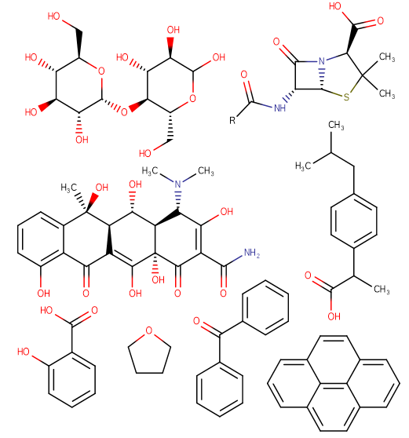
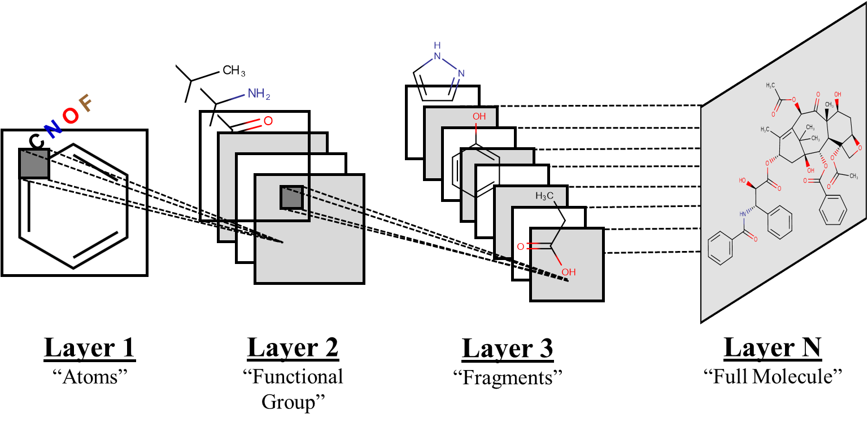
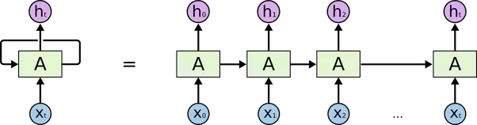
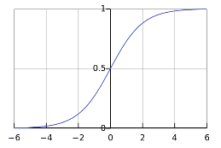
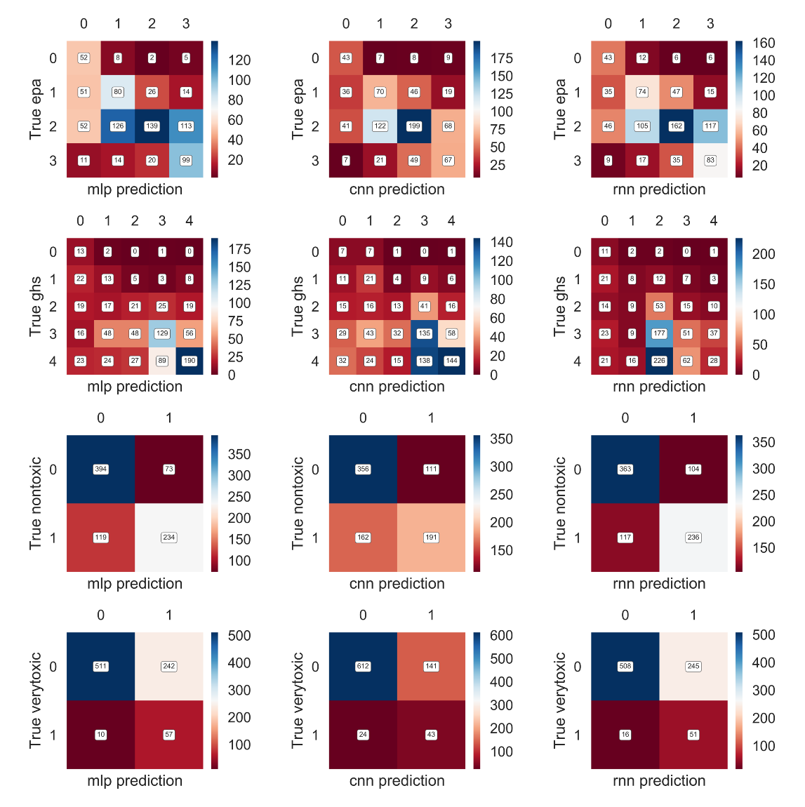
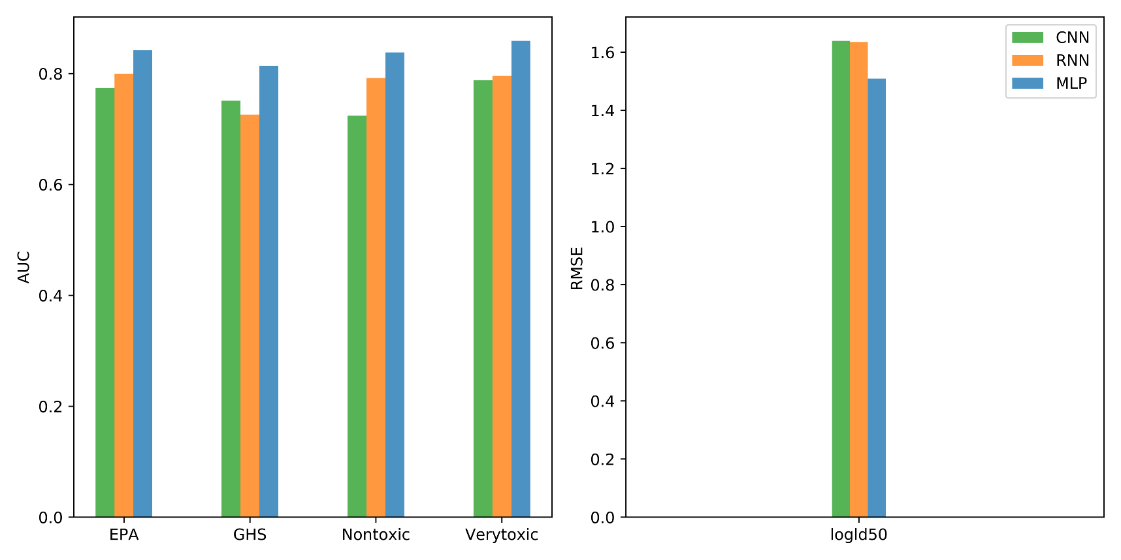
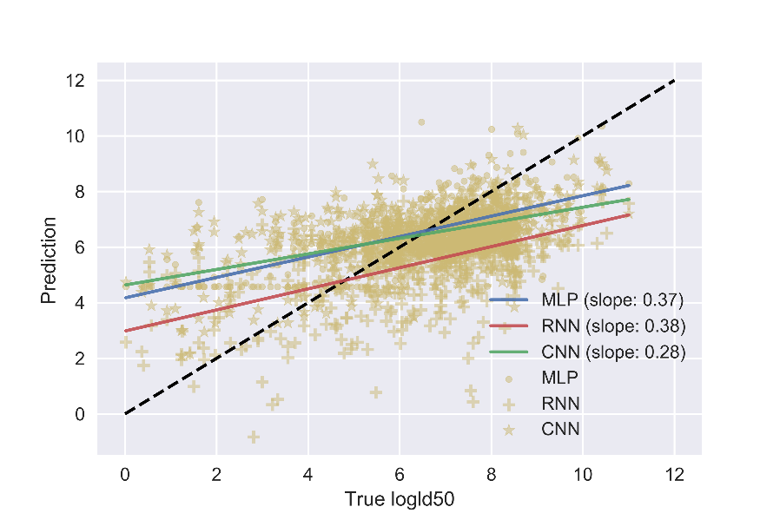






ToxNet: Chemical Toxicity Prediction by Deep Learning
Sijia Xiao, ² Yiming Sui, ³ Luocheng Huang, ³ Garrett B. Goh,^{1,}*
^{1,}*
¹ Pacific Northwest National Lab, PCSD | ² University of Washington, Chemical Engineering | ³ University of Washington, Material Science and Engineering
Introduction
Results
What is our motivation?
Acute system toxicity data are used by a number of U.S. federal agencies (i.e. GHS and EPA), most commonly for hazard classification and risk assessment for acute chemical exposures. Due to the fact that current tests like LD50 still depend on live animals to gain acute systemic toxicity information which is quite cruel, implementation of non-animal approaches to produce these data, meeting the regulatory needs and uses for acute systemic toxicity information becomes pretty urgent and necessary
What is Deep Learning?
Deep Learning = Deep Neural Networks
Why Deep Learning?
The key is Representation Learning = Automated Feature Engineering
Minimal (close to zero) domain expert knowledge required
“Training” paradigm vs “Programming” paradigm
It avoids the high costs and complexities of experiments
Data Converting & Neural Network Developed
169 descriptors derived from SMILES by Descriptors function in rdkit.chem package are list in tabular and directly used as input features to develop Multi-Layer Perceptron (MLP) model.
Uses chemical “text representation” (SMILES strings) to develop the deep Recurrent Neural Network (RNN).
“Chemical Inception” deep Convolutional Neural Network (CNN) model with “universal” network
C\C=C(/C)C
(=O)OCC1=
CC=CC=C1
Chemical
Drawings
Chemception
SMILES
“Chemical Text”
SMILES2vec
Many Hidden Layers
Hyper Parameter Tuning
In CNN, a empirical setting for the network (with 64 filters, 3 blocks and no dropout rate) is used for all 5 prediction situation.
For RNN, due to slow running rate for each epoch, a rough parameter tuning is conducted. The specific value can be checked in our Github Repository.
Table 1 Tuning Results of MLP
Conclusion
Based on running result, we can basically draw conclusion that MLP works well that RNN and CNN for predicting all 5 end points of molecules’ toxicity under the condition that MLP suffer the detailed hyper parameter tuning while the other two neural networks only runs in several selected conditions.
Acknowledge
Special thanks to Garrett Goh’s careful and patient guidance on our project and amazing support from Prof. Jim Pfaendtner and Prof.Dave Beck.
Input
(Features)
Output
(Prediction)
 | drop rate | num_ layer | relu_ type | layer_ units | reg_ type | reg_ value
nontoxic | 0.5 | 2 | Prelu | 256, 32 | L2 | 2.5
verytoxic | 0.5 | 3 | Prelu | 128, 256, 64 | L2 | 2.5
GHS | 0.5 | 2 | Prelu | 64, 16 | L2 | 2
EPA | 0.5 | 2 | Prelu | 256, 16 | L2 | 4.2
logLD50 | 0.5 | 2 | prelu | 64, 256 | L2 | 2.6
Neuron
Neural Network
Neural Network Comparison
Abstract
Goals
For accurately predicting toxicity of molecules, 3 different types of neural network models are constructed which is matched with different modalities: MLP(using tabular data),CNN(using image data) and RNN(using text data). And they will be compared in order to obtain the optimum neural network for predicting the target characteristics separately.
Detailed Work
Data cleaning is conducted due to some missing or junk data. And then the data are converted to engineered features (tabular data), chemical images and SMILES (text) data.
Within each individual neural network, the hyperparameters will be tuned in order to get the best prediction accuracy.
File Name // File Date // PNNL-SA-#####
Fig. 1 Confusion Matrix for Classification Tasks
Fig. 2 Accuracy Evaluation for All 5 Tasks
Fig. 3 Regression Plot for Regression LD50
Selected References
[1] Hamm, J, et al. "Alternative approaches for identifying acute systemic toxicity: Moving from research to regulatory testing." Toxicology in Vitro An International Journal Published in Association with Bibra41(2017):245.
[2] Atteneramos, M. S., et al. "Profiling of the Tox21 chemical collection for mitochondrial function to identify compounds that acutely decrease mitochondrial membrane potential. " Environmental Health Perspectives123.1(2015):49.
[3] Strickland, J, et al. "Status of acute toxicity testing requirements and data uses by U.S. regulatory agencies." Regulatory Toxicology & Pharmacology Rtp 94(2018).
Notes:
NOTE: Print this poster file at 200% SCALE to result in a physical print measuring 60” wide x 36” tall. All type size notations shown above are based on the final printed size of the poster.
• Contact Digital Duplicating (375-2969, http://digitalduplicating.pnl.gov) to order poster printing and finishing services for your completed poster design.
• Remember to have your poster cleared for public display/distribution through the Information Release system (http://informationrelease.pnl.gov).
• Sidebar “About PNNL” box is considered optional, and can be removed if space is needed for technical content.

